Slide 1
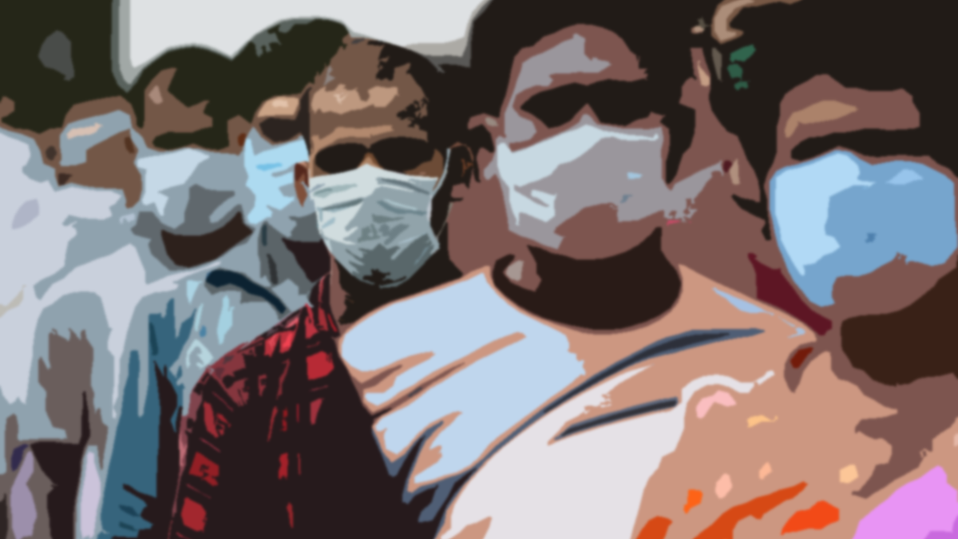
India’s Journey through the Coronavirus Disease
WPSG – Group Activity 1
Done by: Group 4

Slide 2
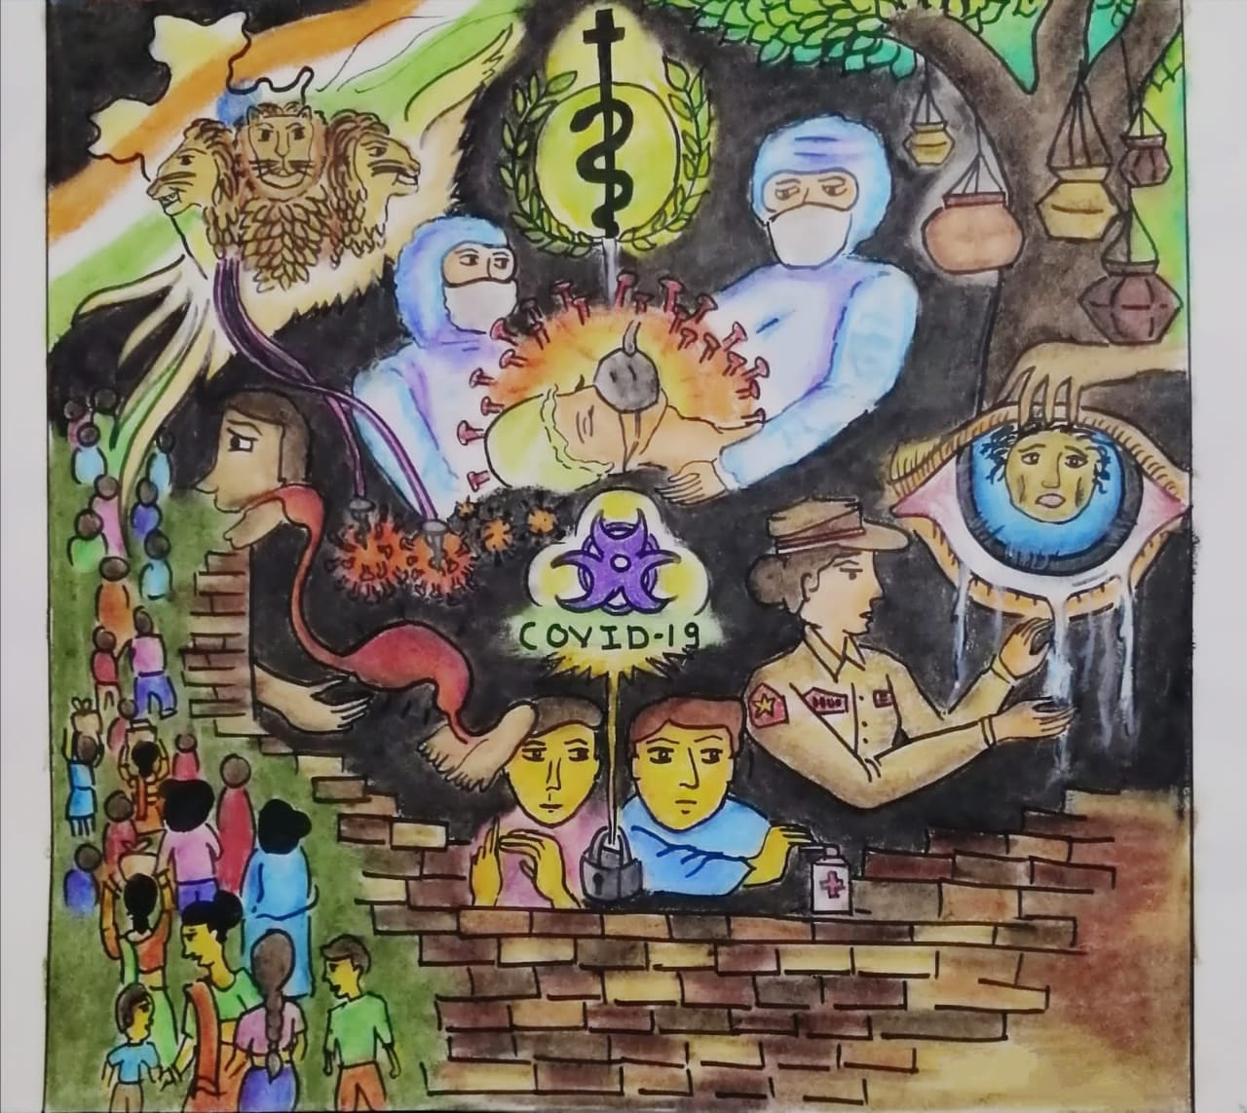
“We are only as strong as we are united, as weak as we are divided”
Drawn by – Nandana

Slide 3
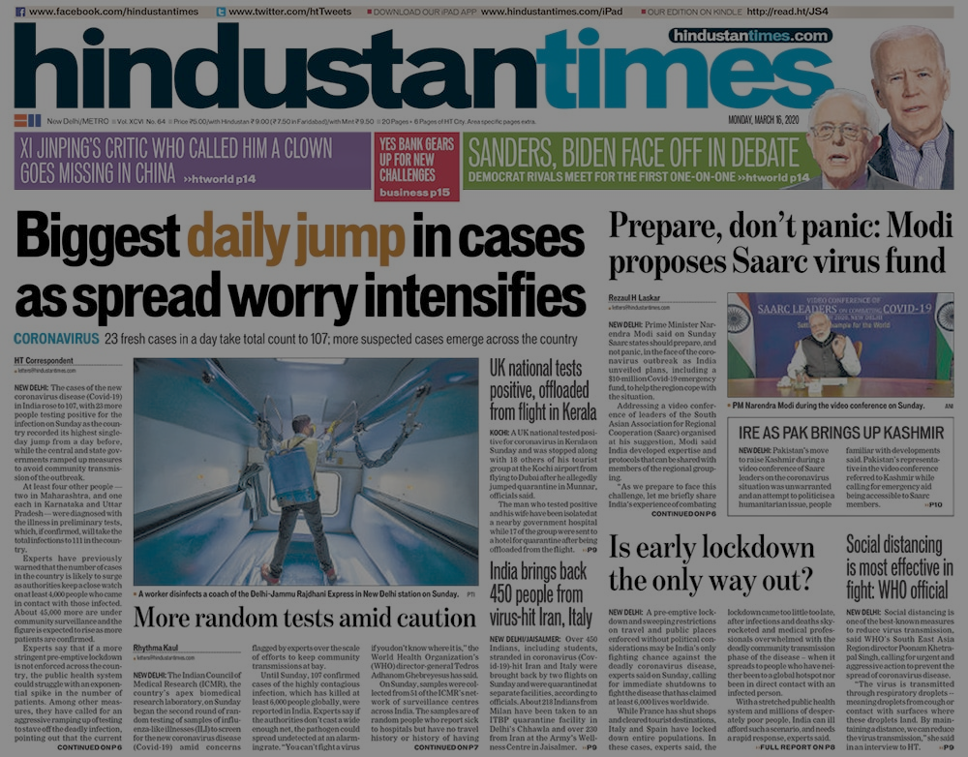
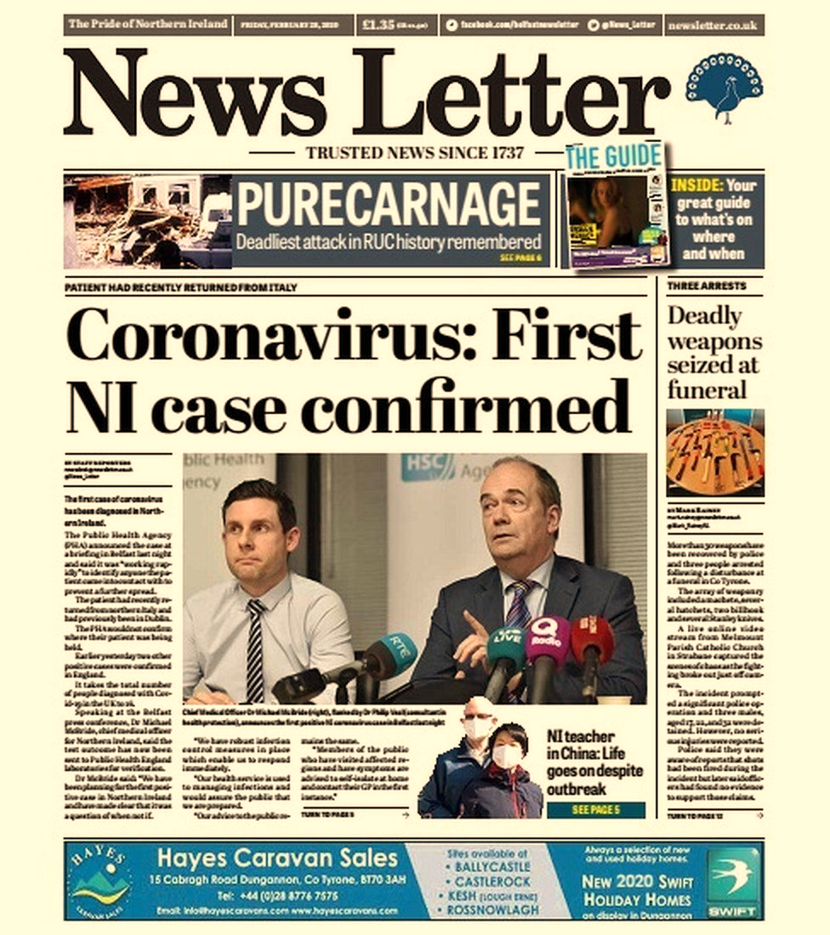
Coronavirus - The Beginning

Slide 4

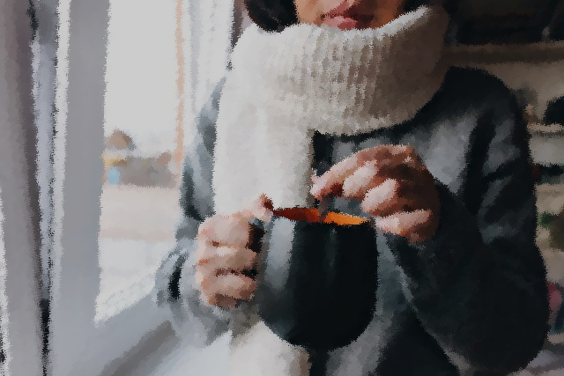
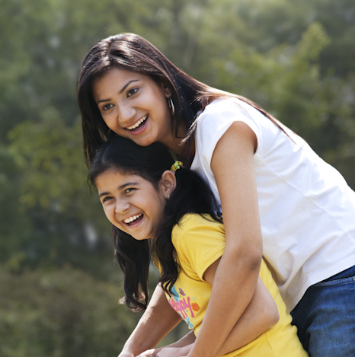
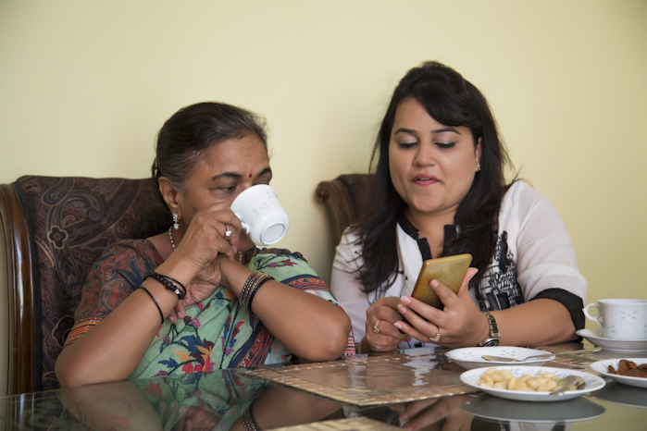
The Peace before the Storm
It was just another bright and cool February day, and you had just come home from the theatre nearby, inhaled a breath of fresh pure air standing in your balcony, glaring at the children playing cricket in the playground by your building.
As you check your notifications, you, along with billions of other people on the planet, scoff at the news of the new Corona Virus Disease that has started gaining slight momentum in your country.
Little did all of us know, what was to come.

Slide 5
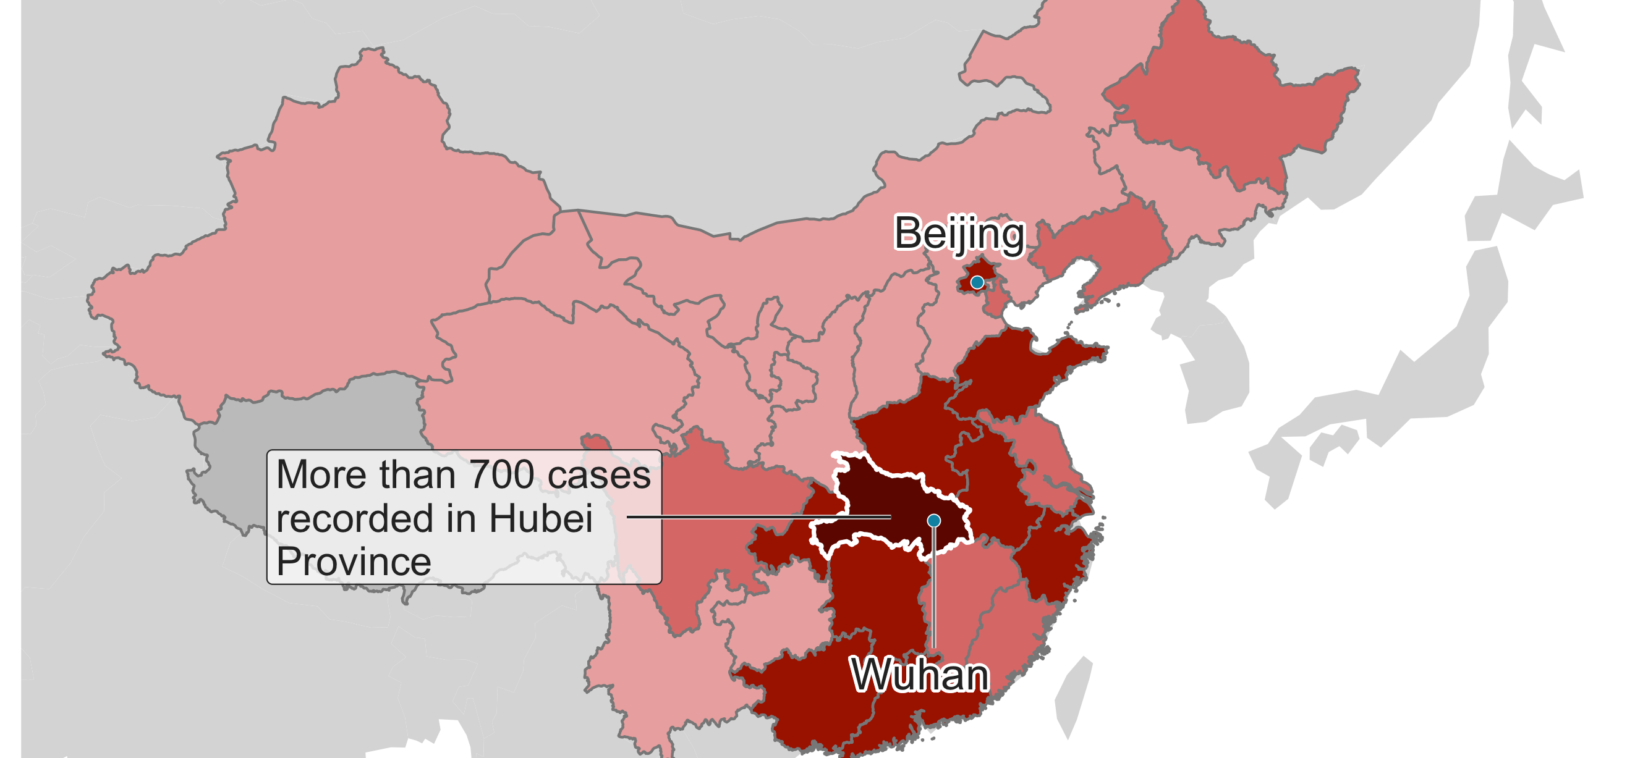
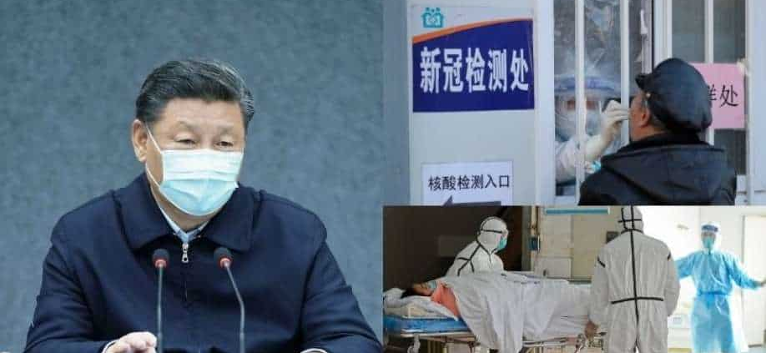
The One Fatal Mistake
On November 17th, 2019, The Chinese Government decided to ignore the first case of the COVID-19 Alpha variant.
Inevitably, this trend was followed by The Koreas, The USA, UK, Italy, and every other country on this planet, until the situation got out of hand.
This for India happened in March of 2020. 7 cases on March 1st rose to hundreds in a matter of days, and thousands in a matter of weeks

Slide 6
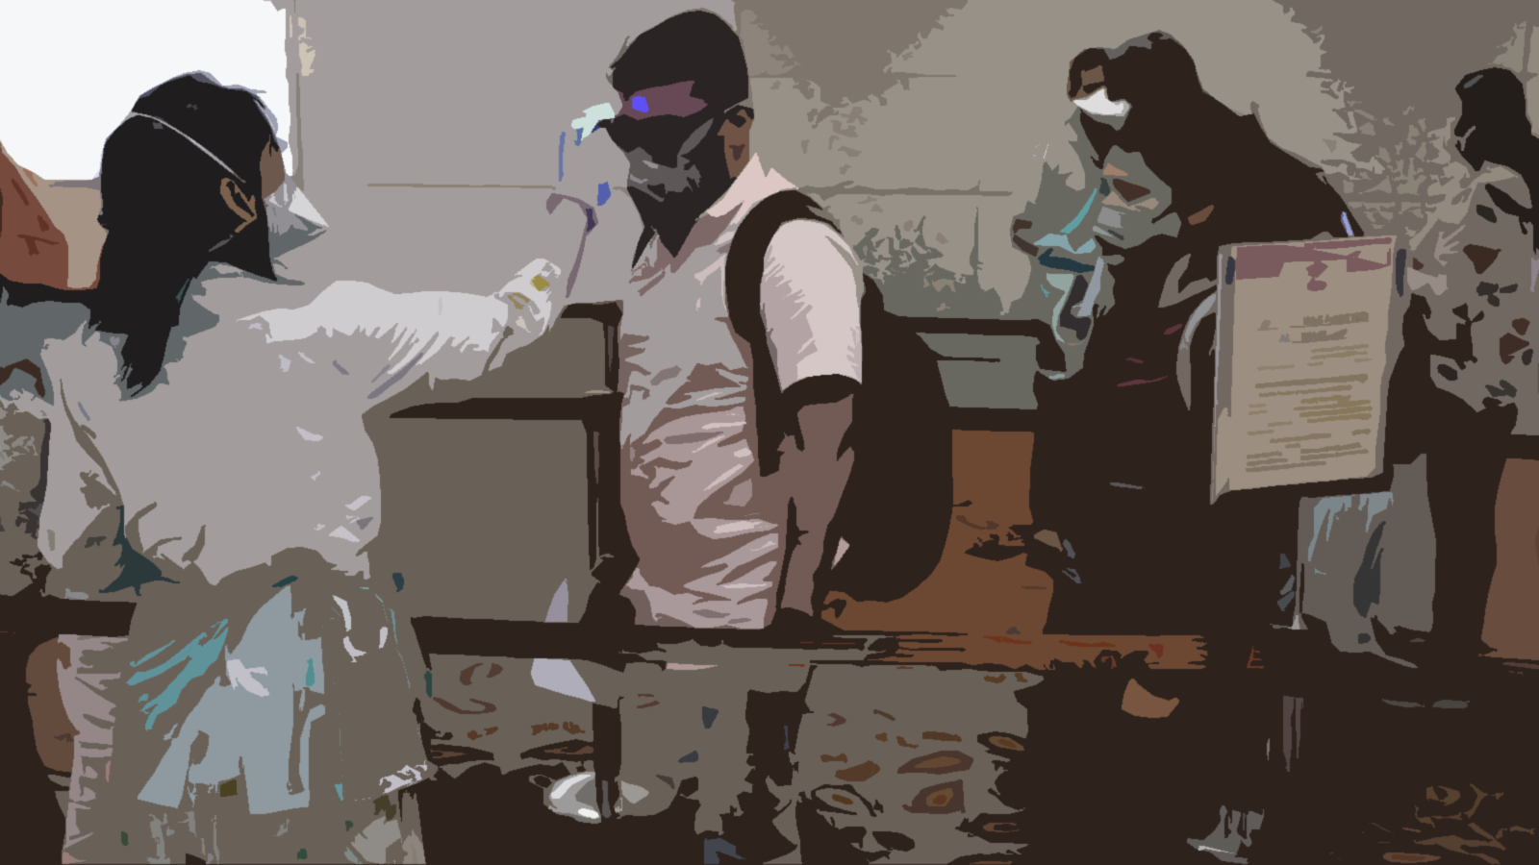
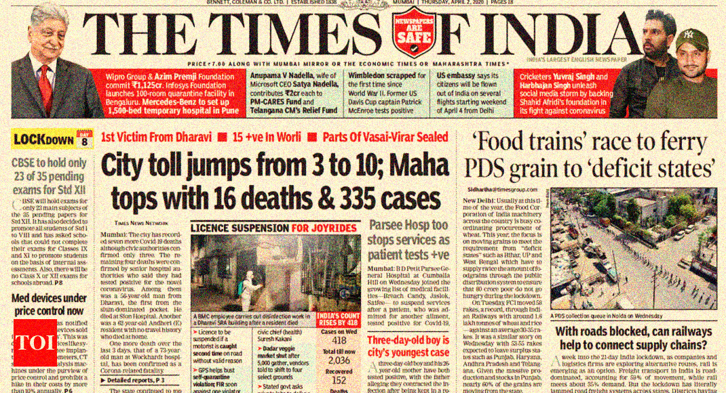
The Initial Confusion
Of course, the population was awe-struck, and deeply hit by the news. The virus struck us in several waves, because so did the awareness, information, and precaution.
A wide majority of the population straight up refused to believe the existence of the disease, while others disregarded its significance. It was a state of dormant panic, one that was about to erupt.

Slide 7
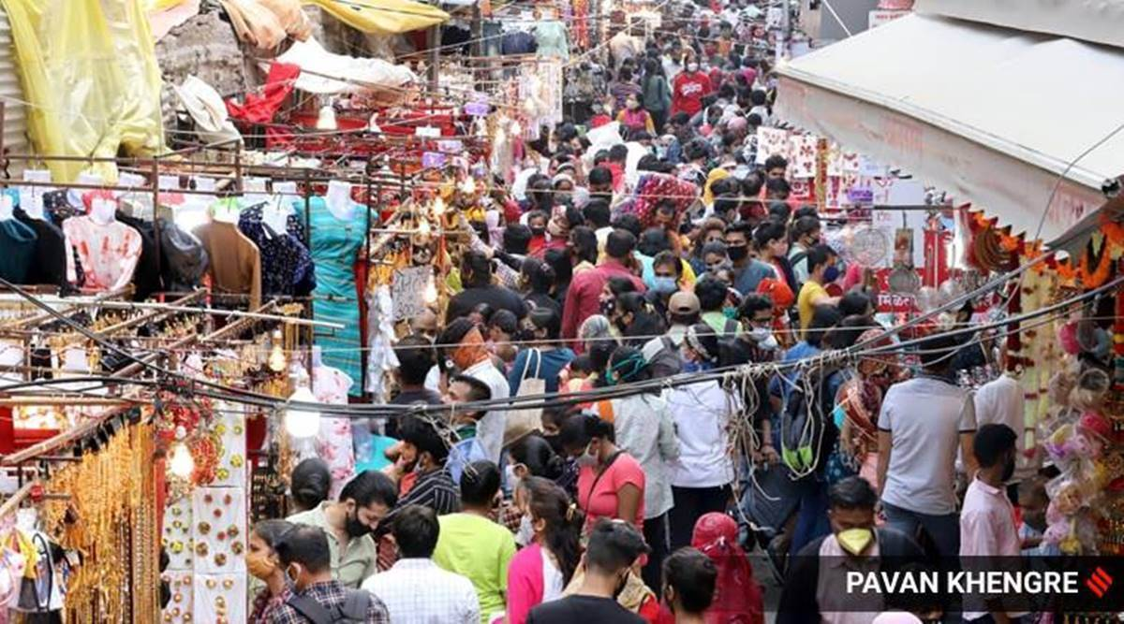
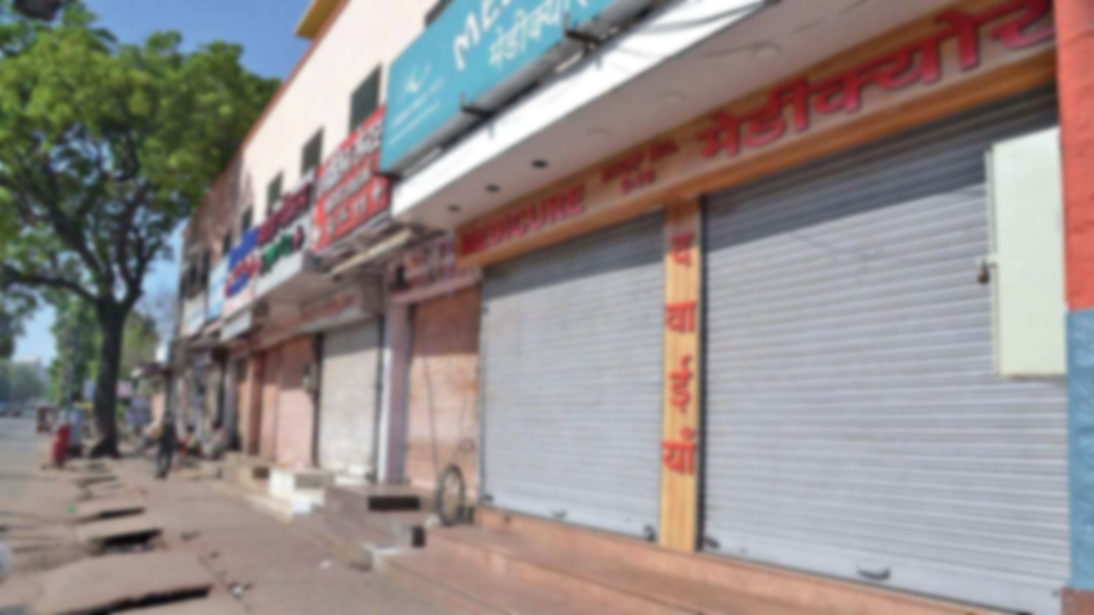
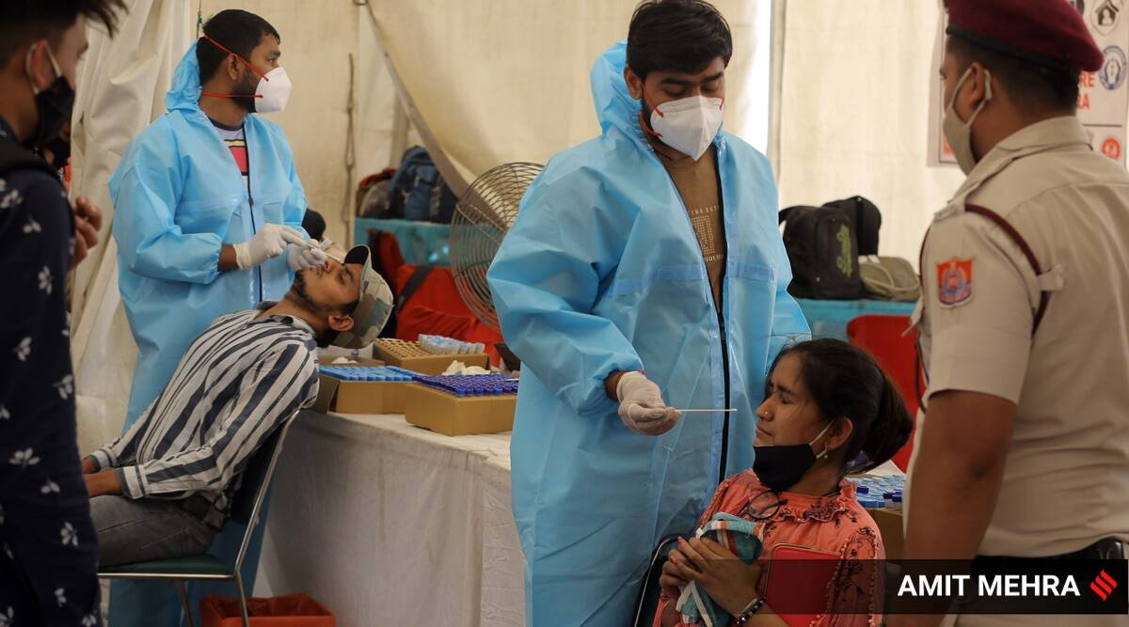
The Panic
Our people had never seen, heard, studied, or experienced an event, even comparable to this one.
Mass confusion, panic, deaths, cases and information erupted in the media as soon as the government of India decided to close educational Institutions, workplaces, and Impose a pan-nation Lockdown on March 24th 2020.

Slide 8
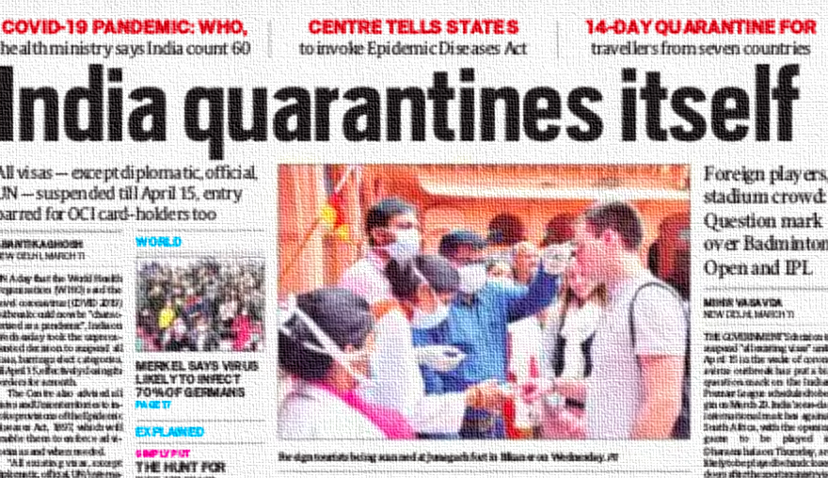
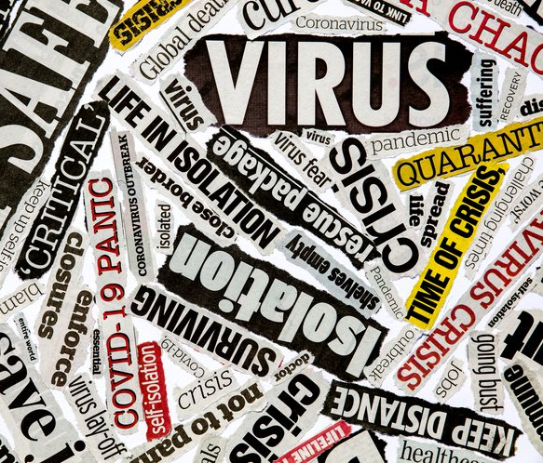
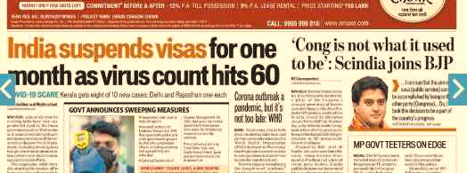
The First Wave

Slide 9
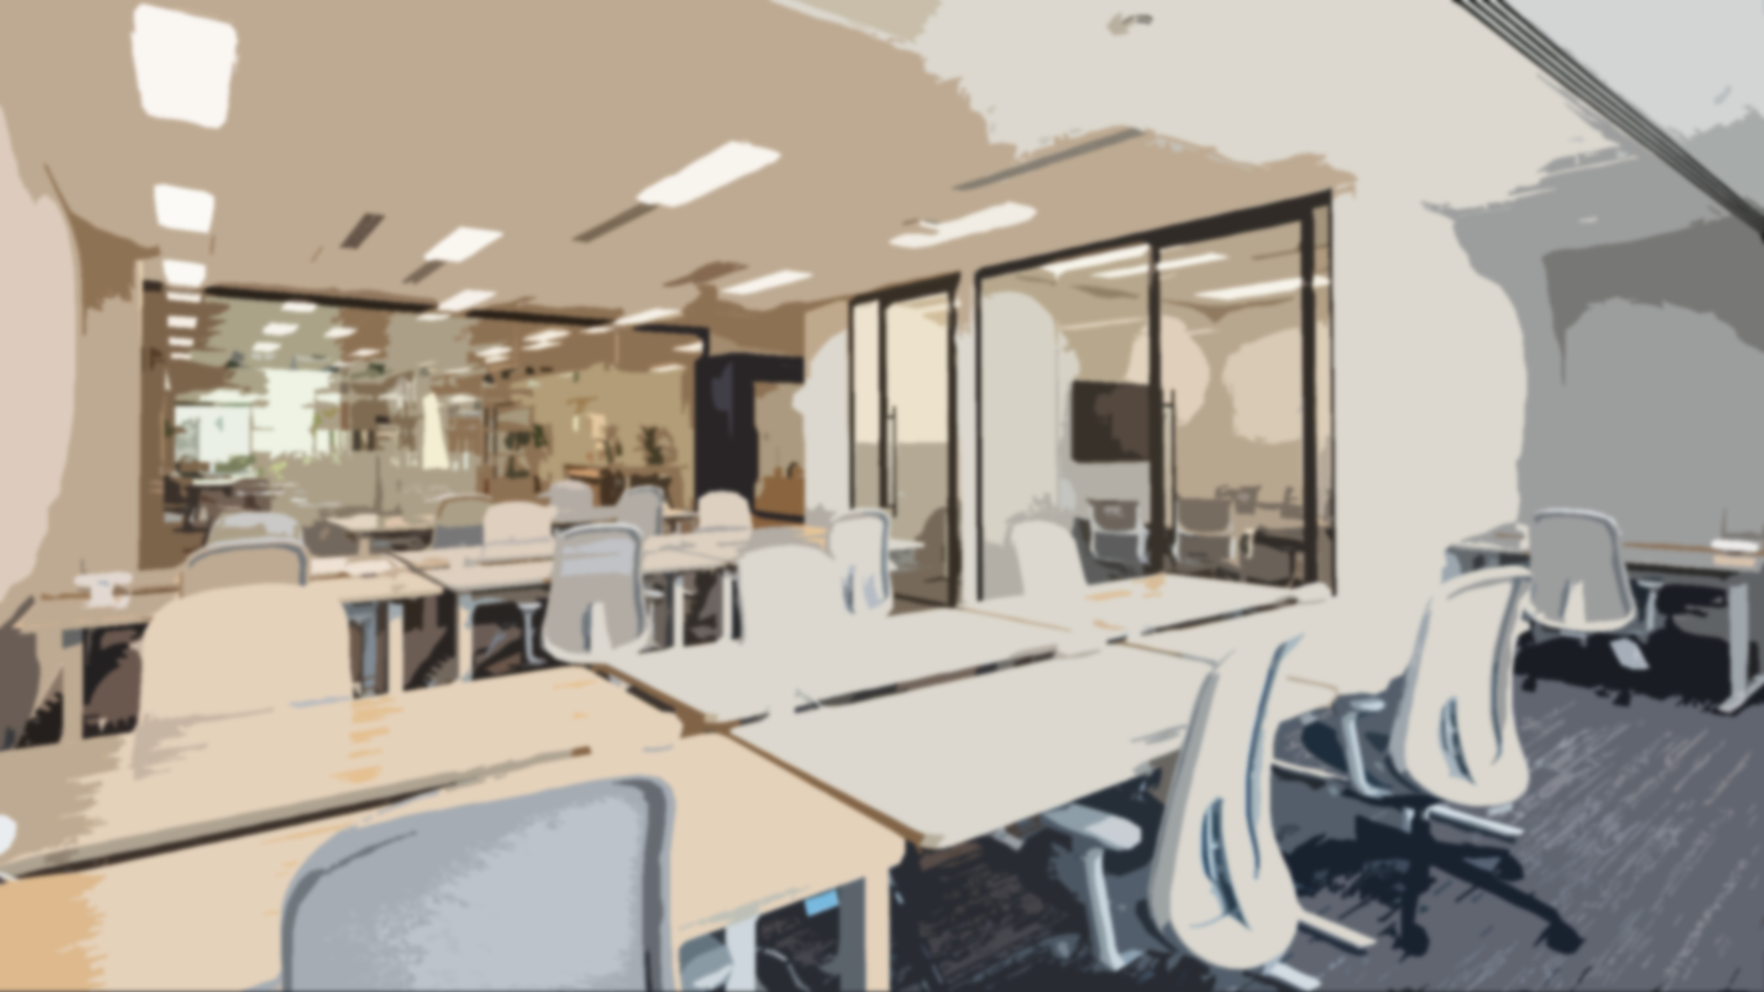
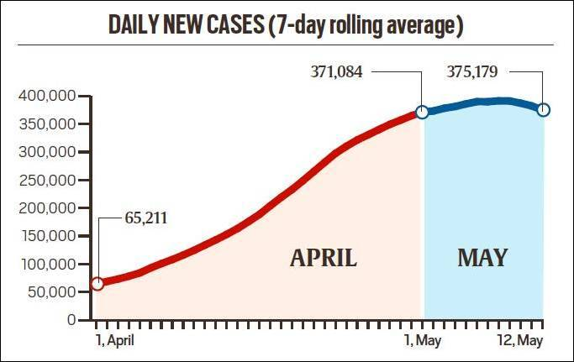

The Dominoes begin Falling
The virus was gaining traction day by day. The curve representing cases to number of days was growing exponentially just as predicted by scientists ,and denied by the people.
The first wave, and the subsequent Lockdown saw 1 out of every 10 Urban Indian household loose their jobs, and the inevitable mass movement and shifting towards the unorganized and rural sector in hopes of meeting financial needs.
The first wave lasted from March until September. Institutions, Offices, Schools, Universities, hospitals, as well as the common businessman suffered insufferable losses financially, mentally, as well as emotionally

Slide 10

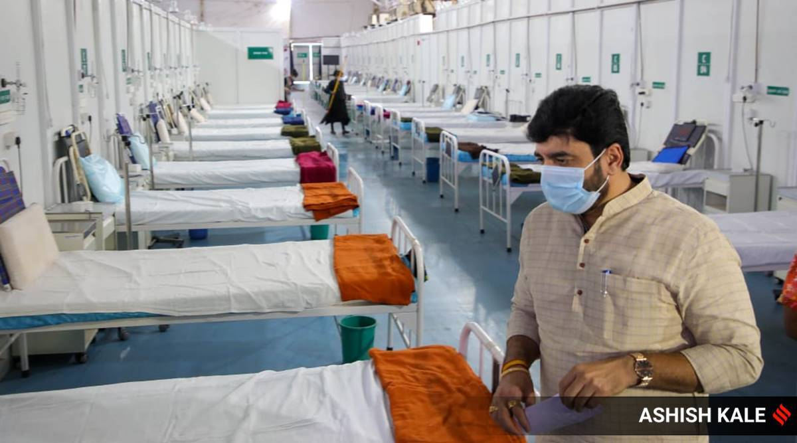
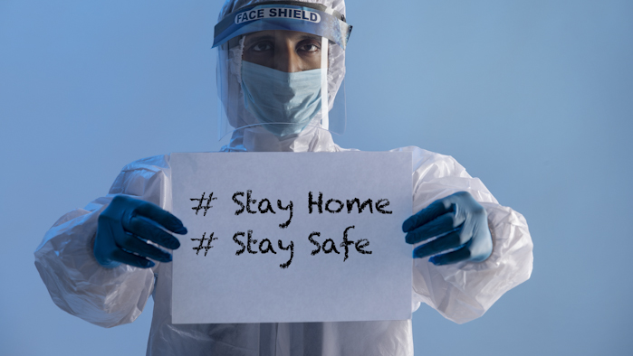
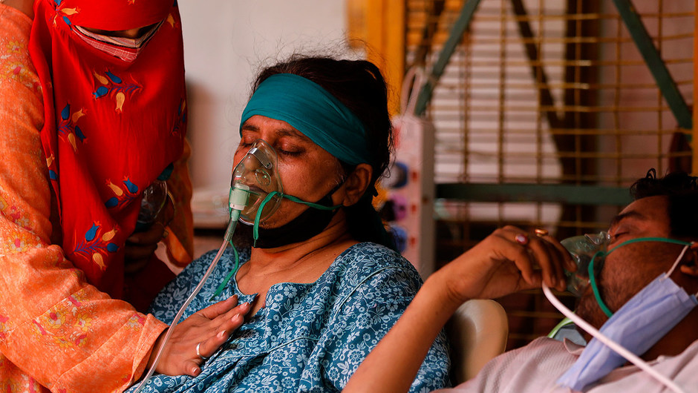
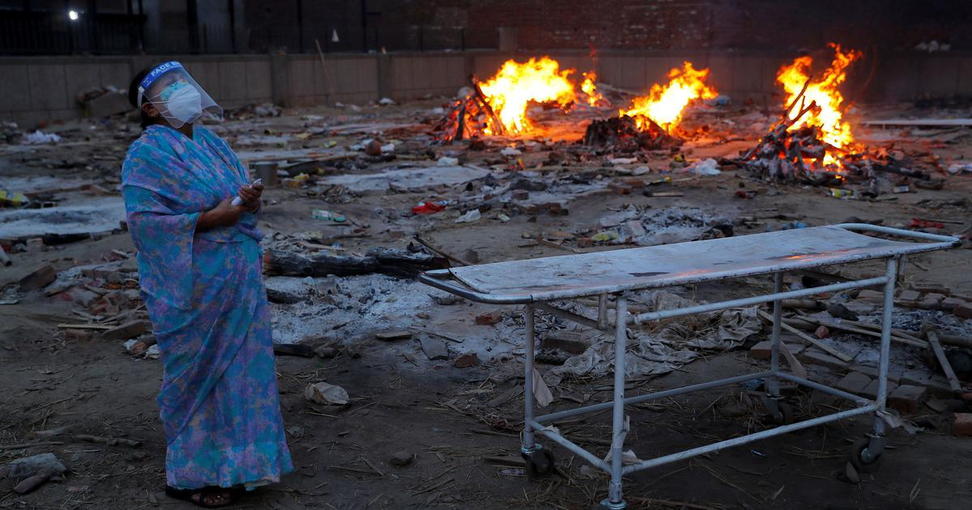
“We are living through what will be History”
The Lockdown saw the emergence of a wide variety of sources of revenue created out of desperation, cries of help, and the constant reminder that we were living what will be learnt in the future books as the most significant event of human history till date

Slide 11

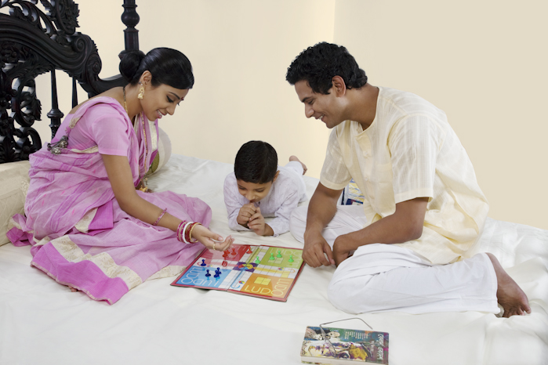
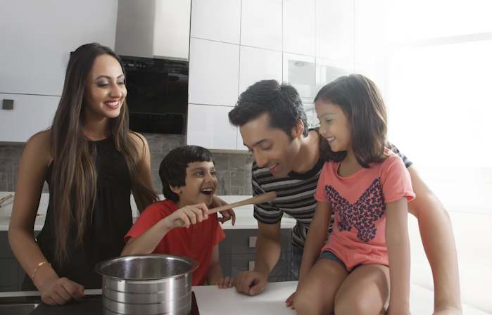
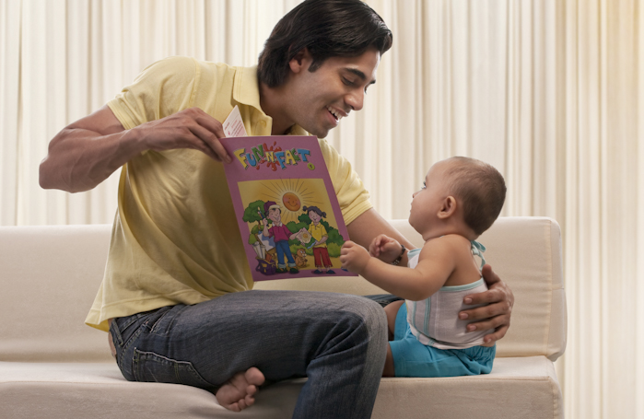
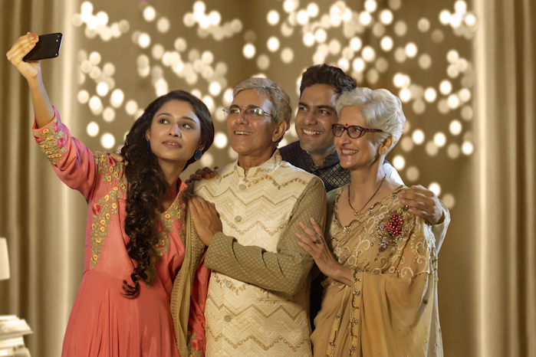
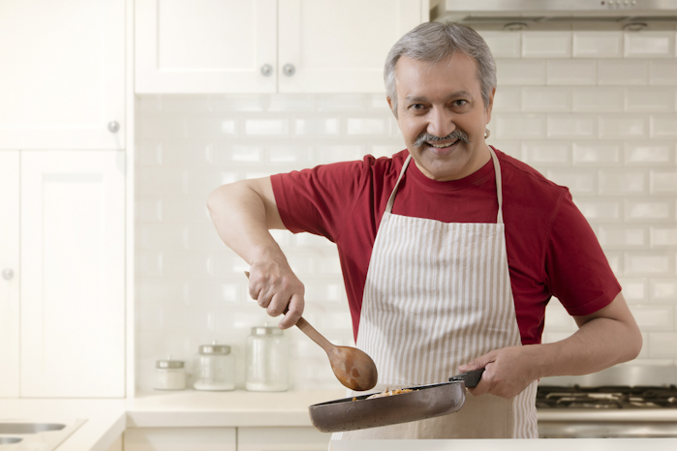
A moment of Happiness in the Suffering
It also gave time and opportunity for us to spend time with our families, reflect on ourselves, and nurture dormant hobbies, which was perhaps the only takeaway from the events. Soon enough, the first wave receded, and the "Unlock 1“ began

Slide 12
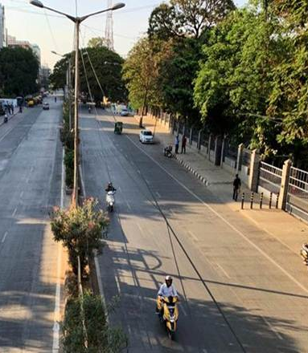
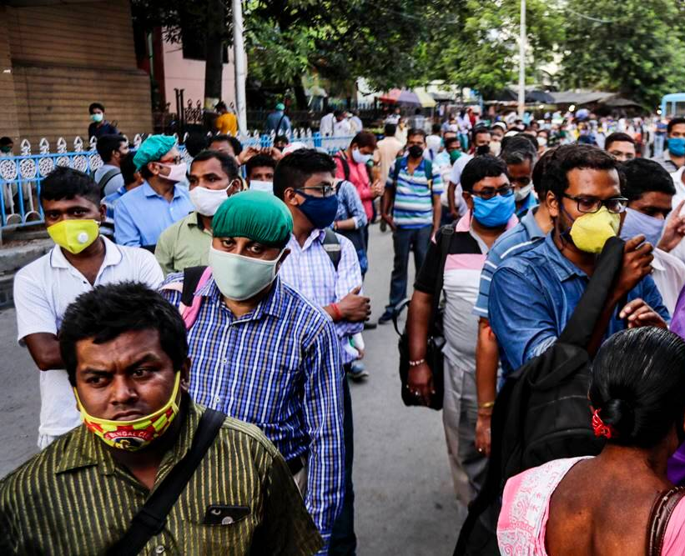
The Fool’s Paradise
The first lockdown was lifted in various phases. First one began around July when cases reduced, and varied in different parts of India, state governments imposing Lockdown whenever necessary based on their current situations.
Eventually, many times, it felt like everything would gradually return back to normal. People began walking on streets, going on regular jobs, and the possibility of reopening of Schools created kindled various emotions in the hearts and minds of 50% of India, which had not seen the doors of their educational institutes from months, and were fortunately, or unfortunately deprived of their education.

Slide 13
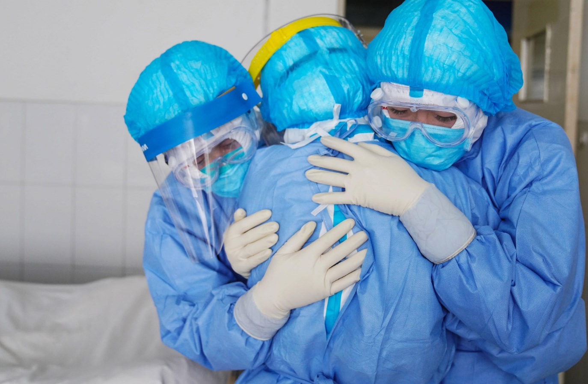
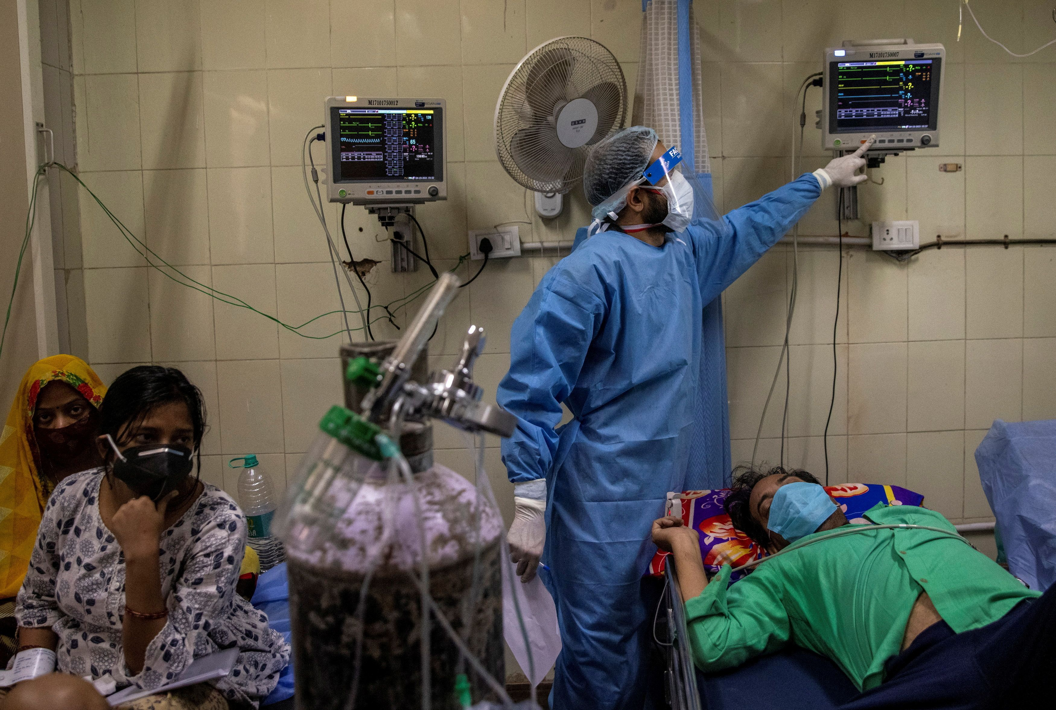

The Second wave

Slide 14
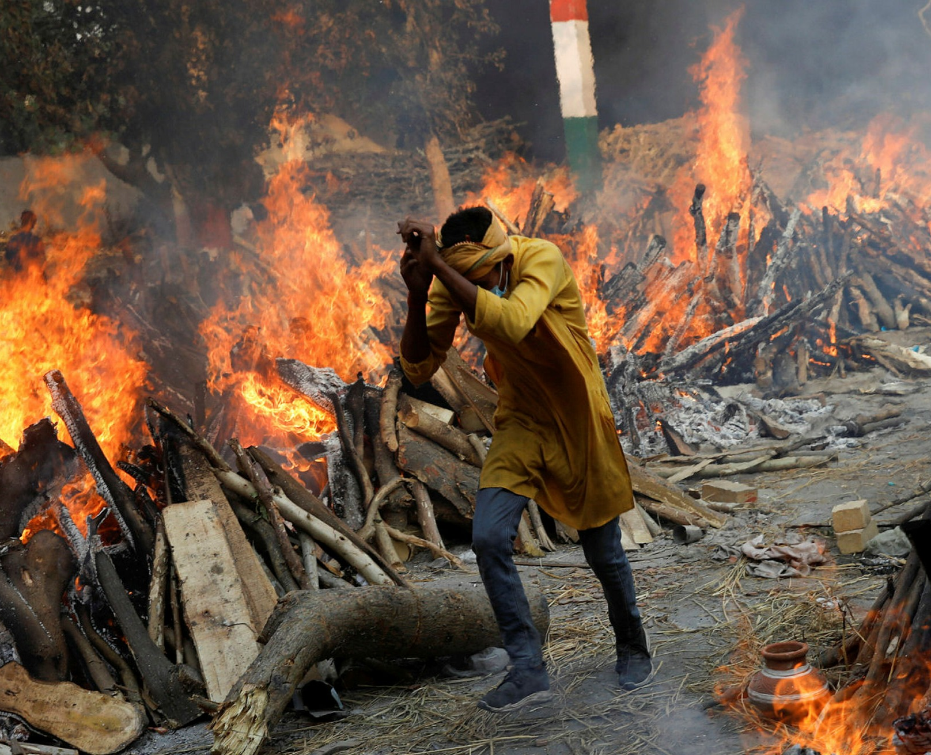
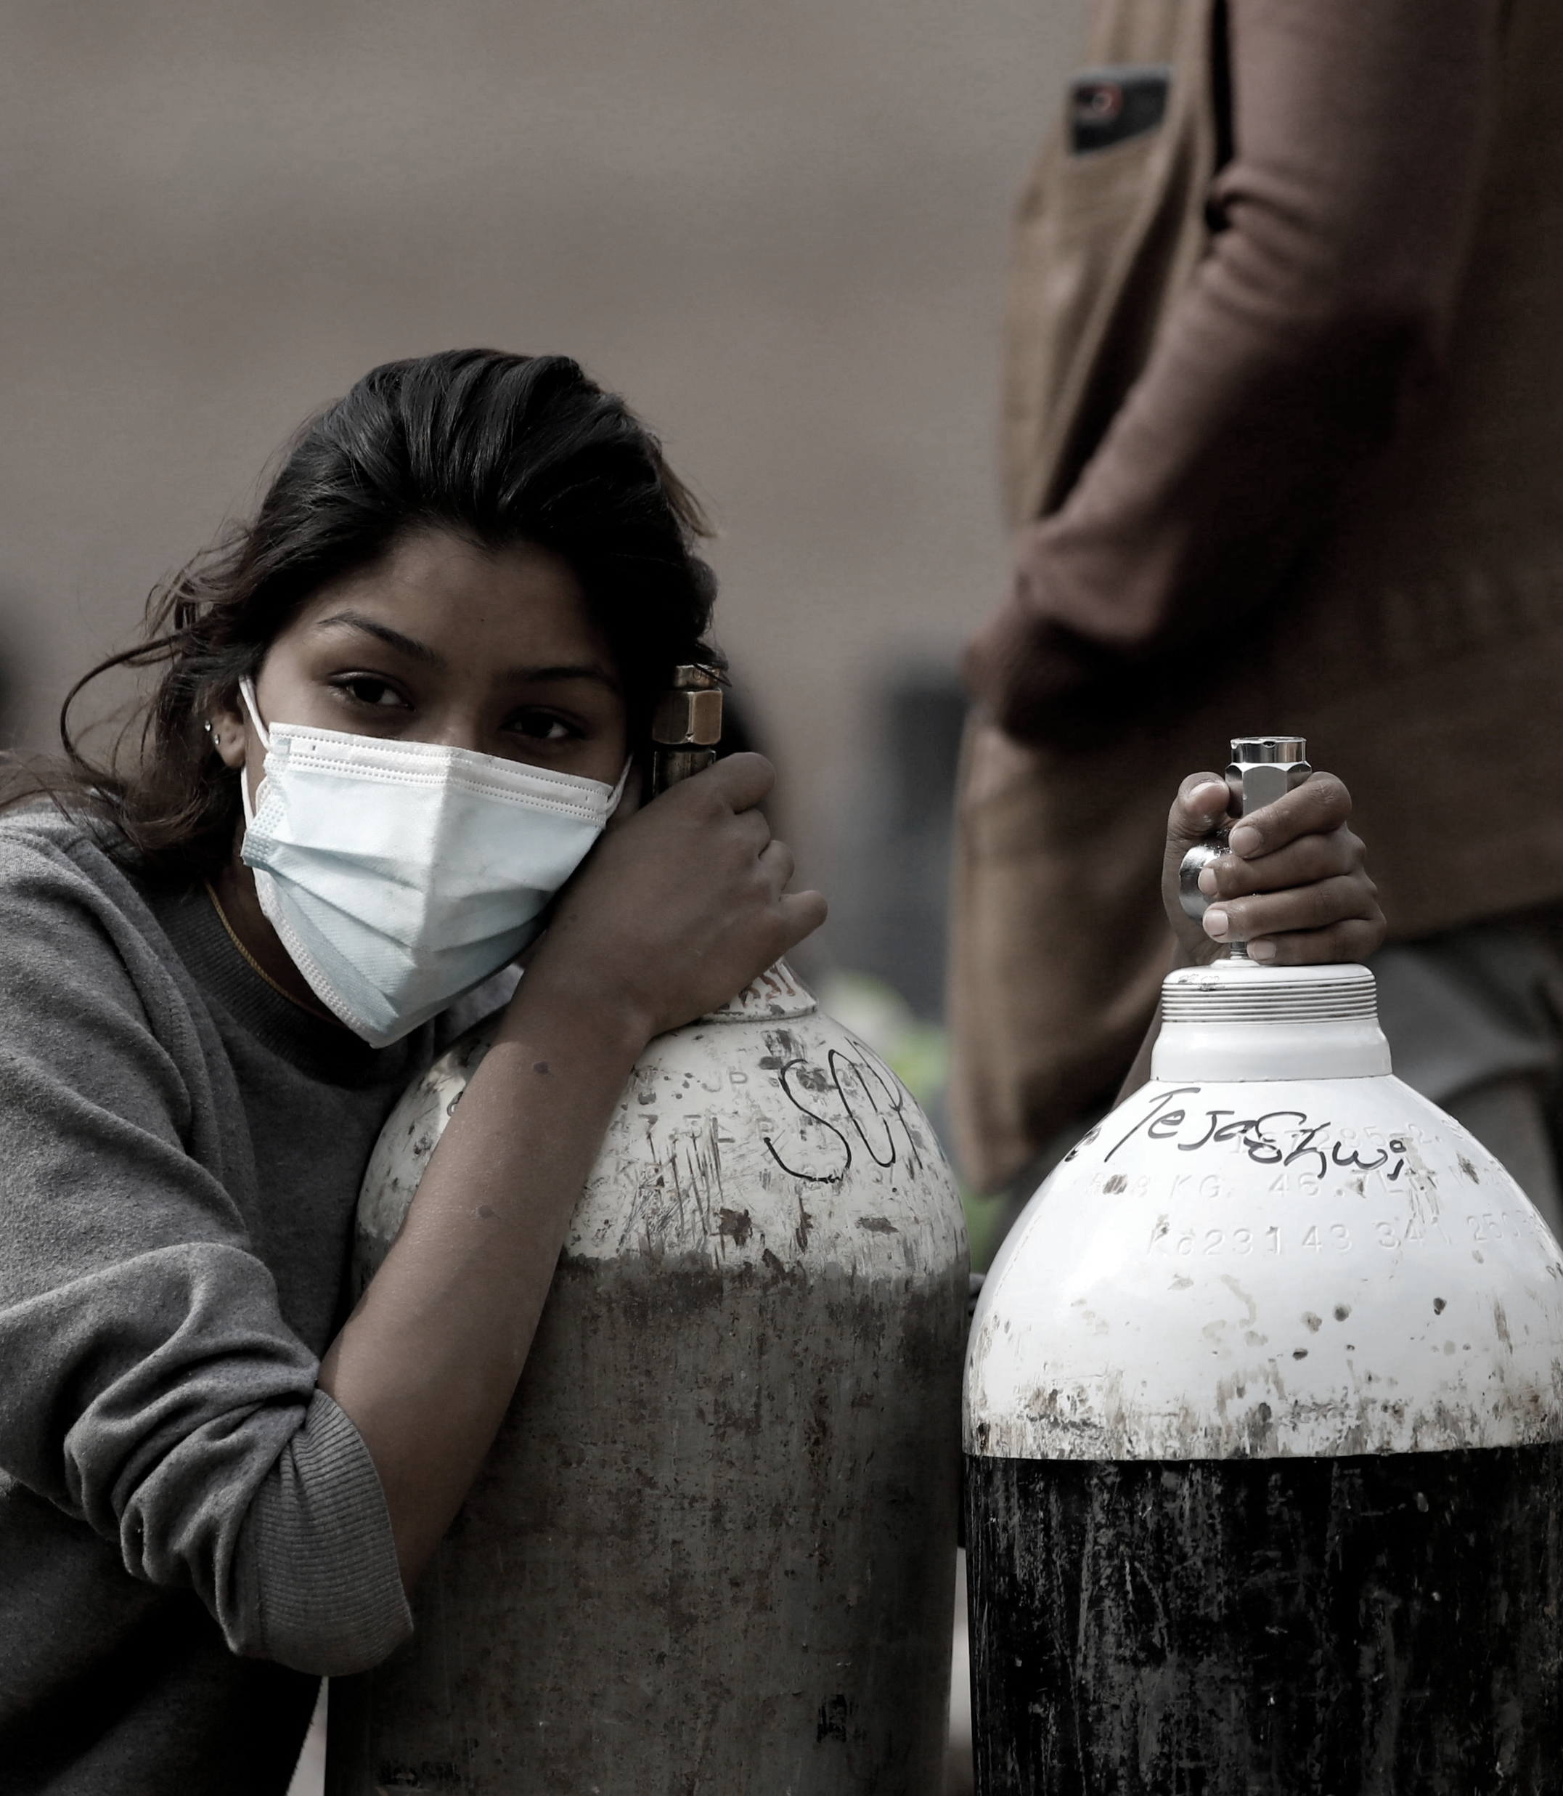
The Storm.
Situation was alright till September when India broke its own record in fresh covid19 cases in 24 hours. Everything started repeating again. Lockdown was imposed yet again.
This time situation was worse than before. New strains of virus started emerging in the country. It was an alarming situation. People weren't ready to stay at homes again. The second wave was the worst till date.

Slide 15
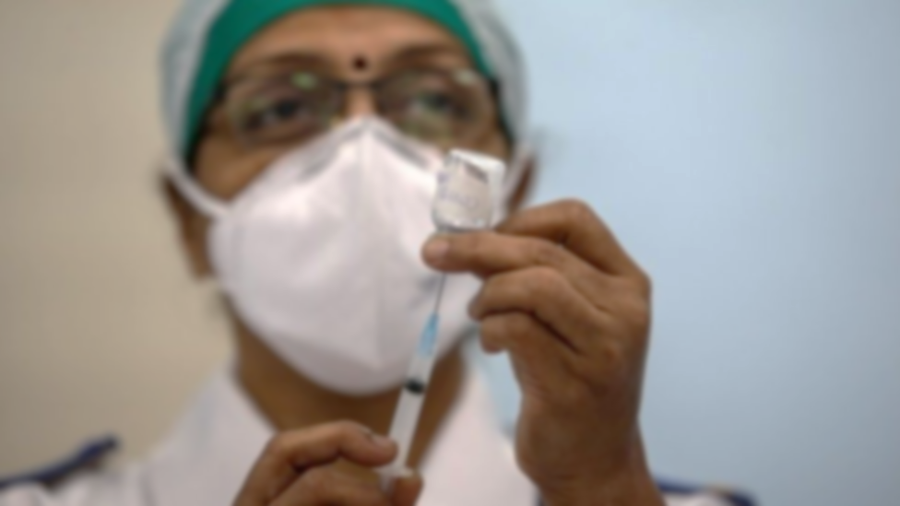
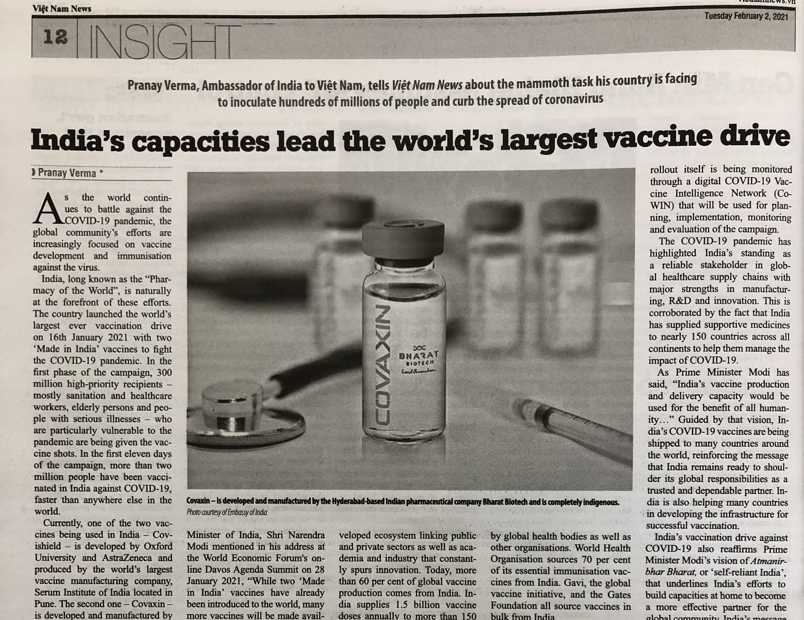
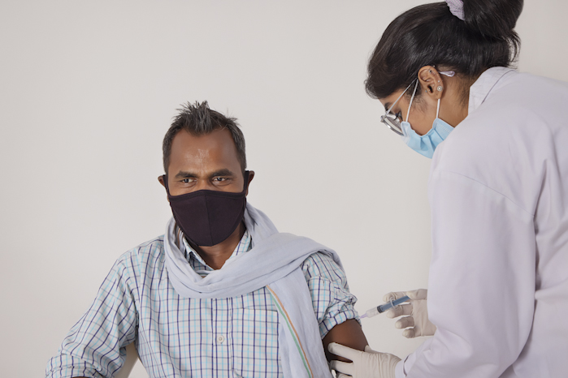
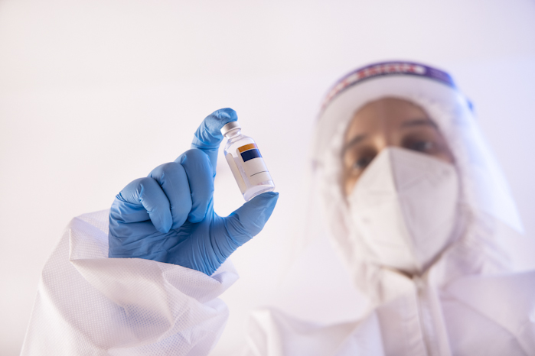
The First Ray of Light
Hopes began kindling in the minds of everyone, as the introduction of the to-be released Vaccine was announced. There was finally some light from the other side of the tunnel

Slide 16
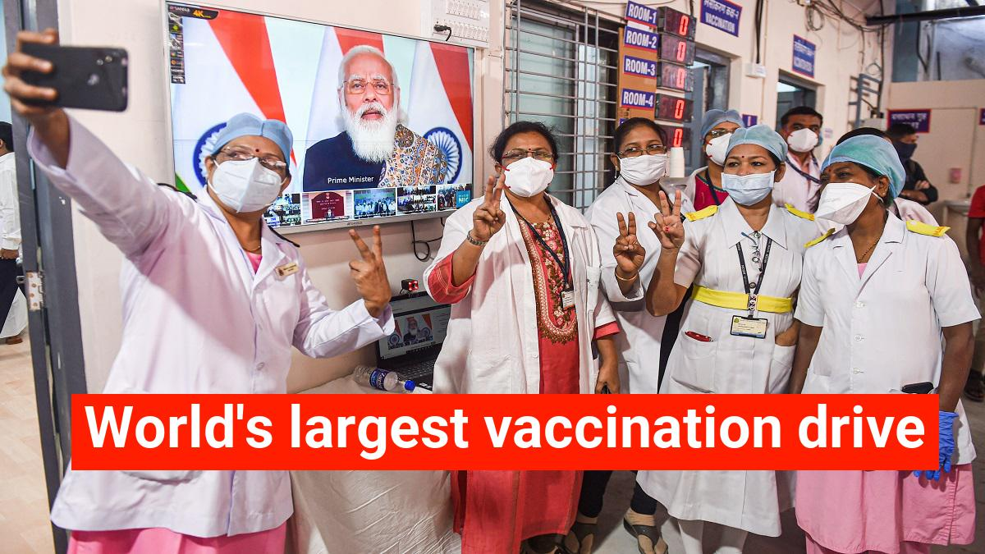
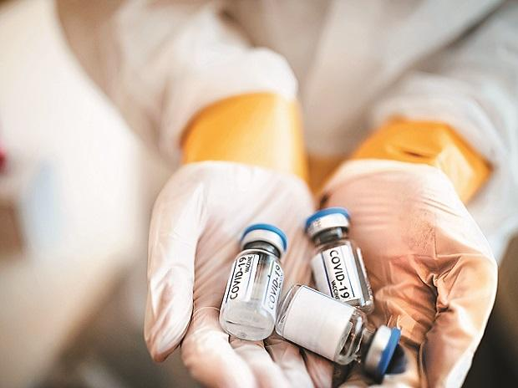
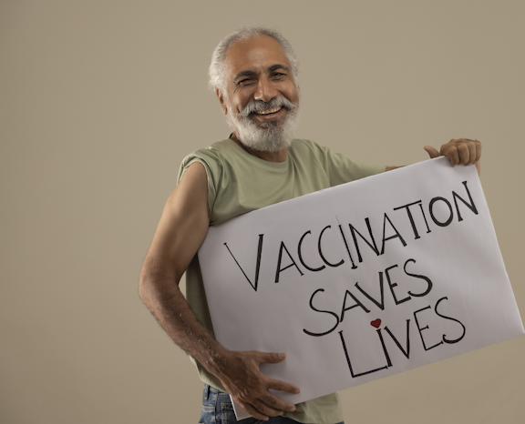
The Gradual Rise from Despair
After the patients were becoming less the state governments decided to slowly open the shops naming it “Unlock 2.0”. There was still fear in the minds of people. But then again after the unlocking started, people started to make a crowd again at the tourist places.
Things slowly started going back to normal.

Slide 17


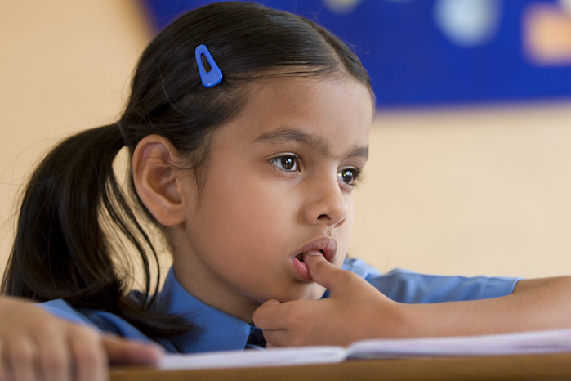
Question Marks – Our new lifestyle
Third Wave?
Schools Opening?
Vaccine?

Slide 18
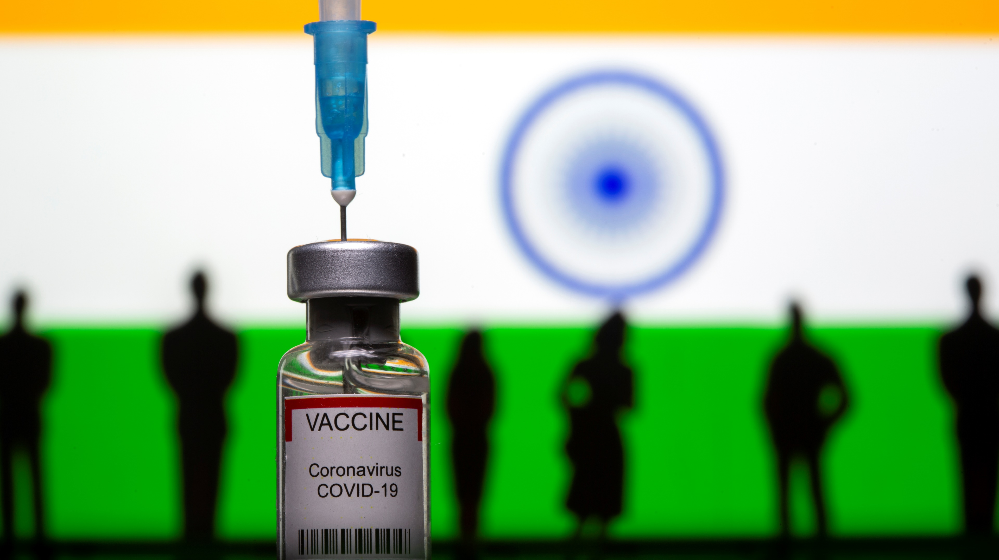
What Now?
At a time when India has barely put behind the horrors of the second wave of COVID 19 pandemic, many states such as Maharashtra, Gujrat, Karnataka and Kerala have sounded alert for the third wave, warning us of the newly evolving delta variant.
In India There is a high possibility of the third wave of covid because as the second wave has flattened people have again started taking the virus lightly.
We can however, still have trust on the vaccination drives, that seem to be our only hopes out of this mess.

Slide 19
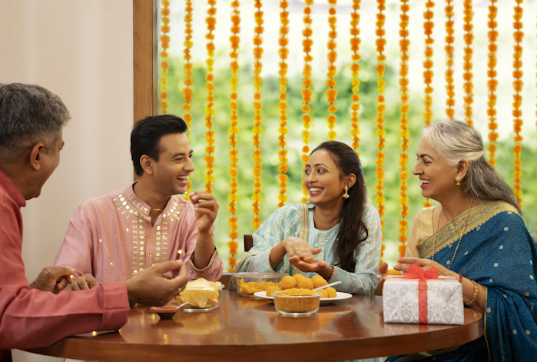
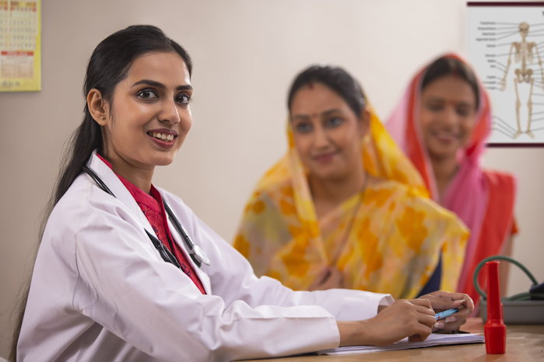

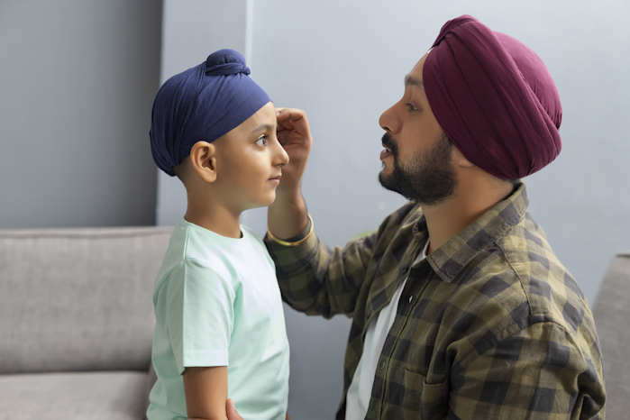
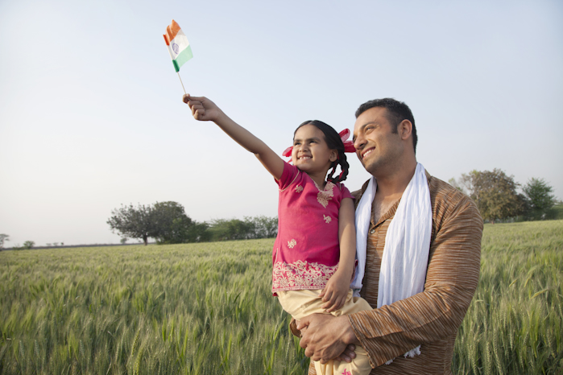

What We Learned
The Pandemic has left our lives in distraught and has tipped our horizons, it’s come as a surprise to all of us and changed the way we live and the things we do on a daily basis.
The lockdown has made us realize the importance of appreciating the things and people that we take for granted, our family, friends, Parents, Luxury, and Freedom. but what it has taught us is the spirit of togetherness and helping others where one can.

Slide 20
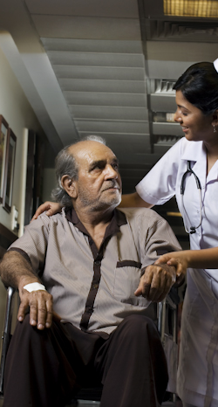
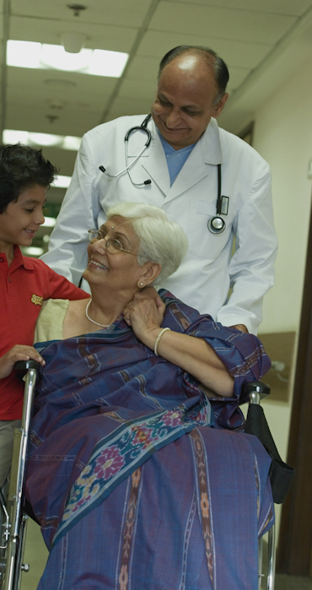
It has come to show us that money and material things are not as important as human life and caring for each other in times of need.
it has shown how greatness can come from working together and what we can do for as a nation and for a nation just by helping where it is needed and wanted.
People came together as a country, rich and poor, young and old, employed or unemployed, literate or illiterate and have shown the world what a little love, care and compassion can do to bring hope and smiles in these testing times.

Slide 21
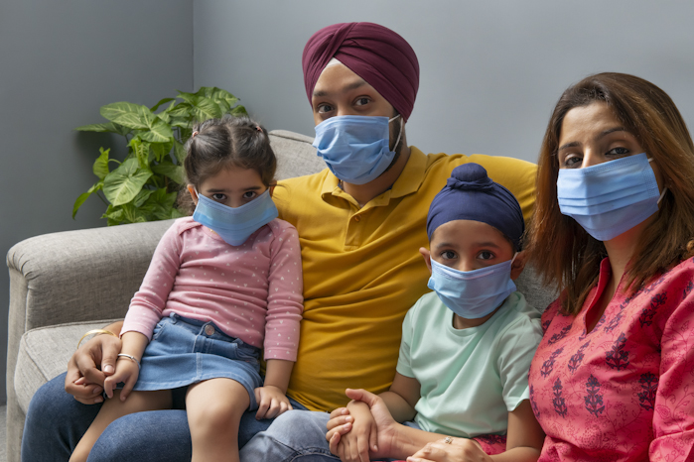

Yes, Unity really is strength.
It has shown that all we need is each other to make the best out of the worst-case scenario. We as a group believe that best we could do right now is pray, help others, follow precautions and be eternally grateful, to our parents, teachers and friends, that we are still able to wake up and see the sunrise and breathe the pure air once again.

Slide 22

Thank You for Listening!

Slide 23

Group Members
04. Nandana Nambiar – Hand Drawing
14. Siddharth Aditya– Lifting of the Lockdown
24. Zameer Siddique – The Beginning
34. Vedant Singh – Third Wave
44. Devanshu Surana – First Wave
54. Krishnaraj Thadesar - Presentation
64. Pushkar Vaswad – Second Wave

